Slide 1

Hiring Process Analytics
By sarfaraz ahmed

Slide 2
Project description :
Working in a MNC as a lead Data Analyst and the data provided by the company of pervious hirings such as - number of rejections, number of interviews, types of jobs, vacancies . Using the following data answer all the questions

Slide 3
Approach
Starting from understanding the data use of each and every column using the knowledge and with help of pivot tables, statistics and advance excel features trying to explain all the questions .

Slide 4
Tech-Stack
Used
Microsoft Excel 2016
As the Inbuilt features like Pivot table , sorting data , easy to perform calculations and easy to visualize the data

Slide 5
Insights
Answer the following questions using dataset provided using Microsoft excel

Slide 6
Result

Slide 7
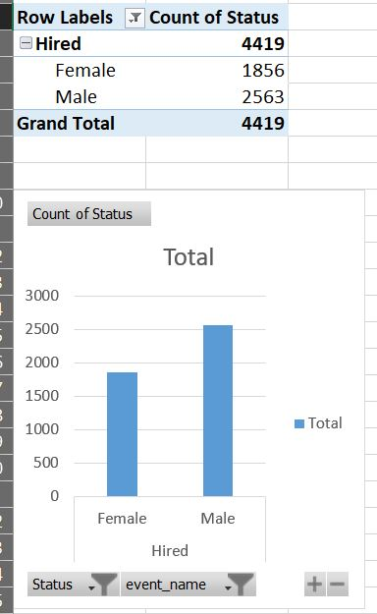
Hiring:How many males and females are Hired ?

Slide 8
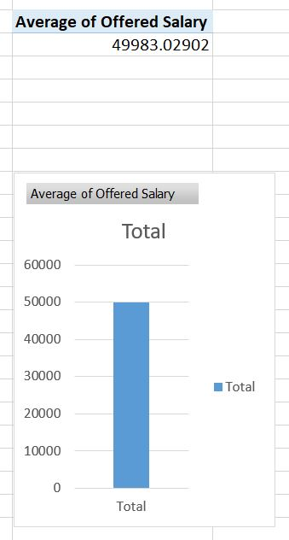
Average Salary :What is the average salary offered in this company ?

Slide 9
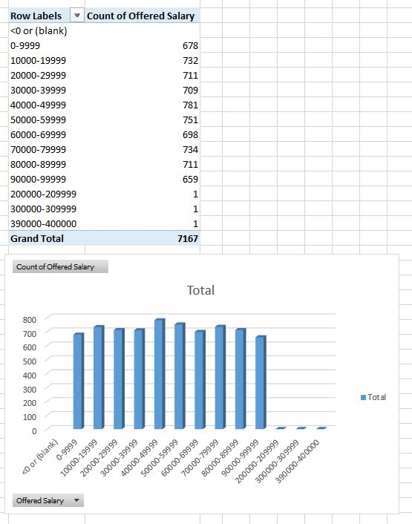
Class Intervals:Draw the class intervals for salary in the company ?

Slide 10
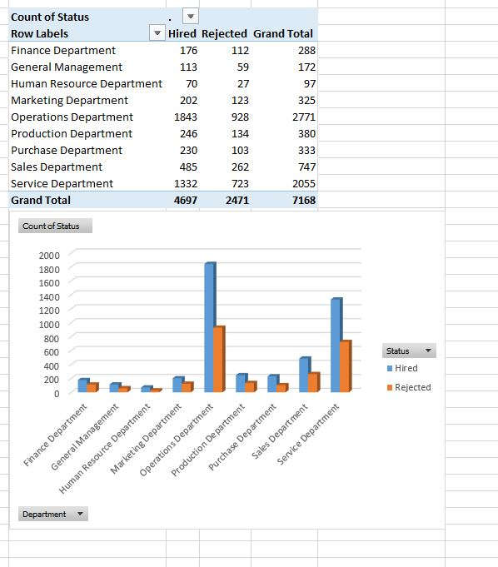
Charts and Plots: Draw Pie Chart / Bar Graph ( or any other graph ) to show proportion of people working different department ?

Slide 11
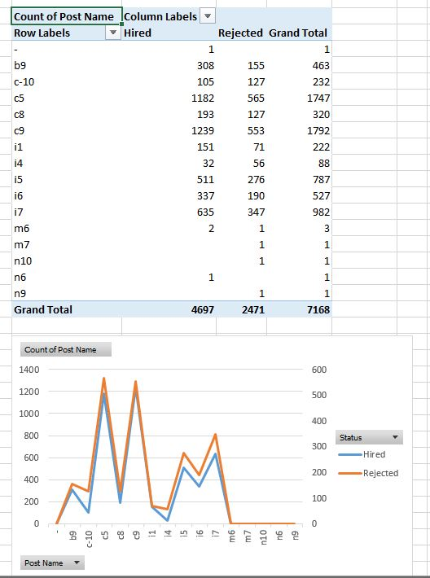
Charts:Represent different post tiers using chart/graph?

Slide 12
THANK-YOU

